Slide 1
Heart Failure Prediction and Analytics
Snehal Padekar
Nishank Dave
Payal Pawar
Swapnil Bhasgauri

Slide 2
Table of Contents
01
02
03
04
05
Introduction
Target Variable
Machine Learning Algorithm
Analytics And Conclusion
Scope of Future Work

Slide 3
Introduction
The Heart Failure Prediction project aims to employ supervised machine learning algorithms to accurately predict heart health status. This project seeks to develop a robust predictive model for identifying individuals at risk, enabling timely interventions and personalized care.

Slide 4
Target Variable
HeartDisease was selected as the target variable due to its profound impact on healthcare, clinical relevance, preventive potential, quality data availability, machine learning challenges, and public health value. Given its status as a leading cause of mortality worldwide, predicting heart disease risk is crucial for early intervention and improved patient outcomes.

Slide 5
Machine Learning Algorithms
Decision Tree
Random Forest
Gradient Boosting Classifier
Logistic Regression
K-Nearest Neighbors
XG-Boost

Slide 6
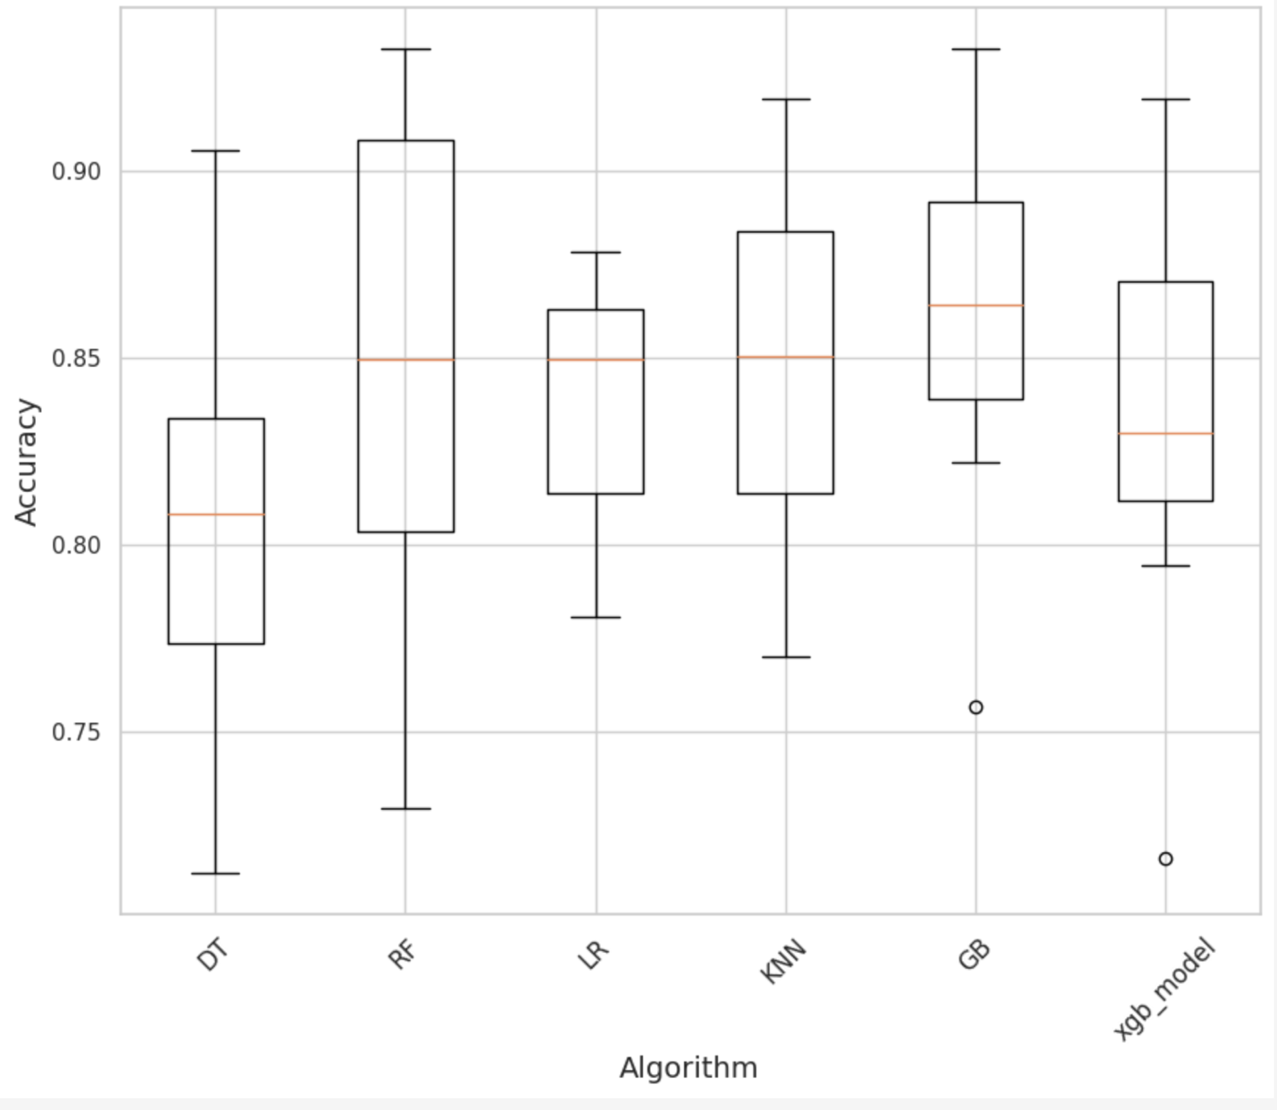
Analytics & Conclusion
Conclusion: Gradient Boosting as the Best Model

Slide 7
Scope of Future Work
Future work includes integrating ECG analytics for improved predictive accuracy and exploring novel features and advanced machine learning techniques. Collaboration with medical experts is essential to validate enhancements, advancing predictive healthcare analytics for more accurate and timely heart disease detection and intervention.

